Slide 1
Capstone Project-Battle of Neighborhoods
Identifying the best hotel location in Siolim,Goa (IN)

Slide 2
Introduction
The best location to establish a hotel in Siolim,Goa (IN)?
Goa is a state on India’s west coast. It is a former Portuguese colony with a rich history. Spread over 3,700 square kilometers with a population of approximately 1.8 million, Goa is small by Indian standards. It has a unique mix of Indian and Portuguese cultures and architecture that attracts an estimated 2.5 million visitors each year (including about 400,000 foreign tourists).
It is a popular vacation destination for both domestic and international tourists almost around the year. It is famous for its pristine beaches, old Portuguese churches and its relaxed environment. Goa’s cuisine is a rich blend of Indian and Portuguese palates.
It has been observed that on visiting Goa, people usually want to pick a hotel which is close to a beach therefore such hotels continue to do a lot of business year around.
Essentially this is the question that we’d like to answer through this project

Slide 3

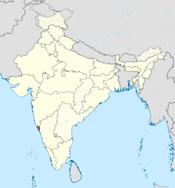
Dataset
We will be completely working on Foursquare data to explore and try to locate our new hotel where more venues like beaches, churches, museums and memorials that are present nearby.
How will we be solving using this data?
We will looking for midpoint area of venues to locate our new hotel. Before that our major focus will be on all venues present in and around the center of Goa.
We will perform some exploratory data analysis on hotels and restaurants present in the tourist spot.
The project notebook will consist of essential libraries and code which will be submitted later on GitHub.

Slide 4
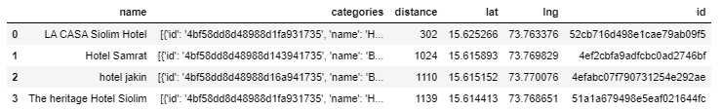
Methodology
We studied the locations of hotels in Siolim , there isn’t too much competition.
There are 4 hotels located close to our co-ordinates :
Siolim location : 15.6243358,73.7660284)

Slide 5
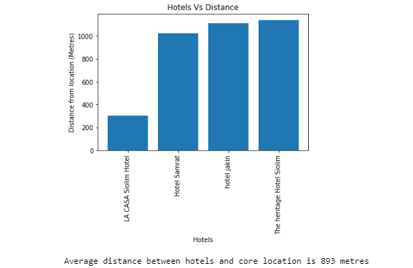
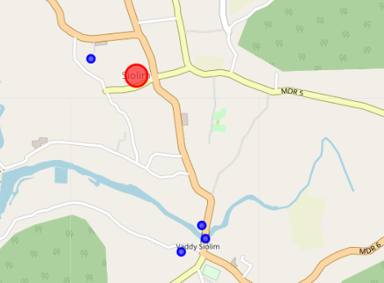
Map of the location
The average distance of these hotels is 837 M from the center

Slide 6
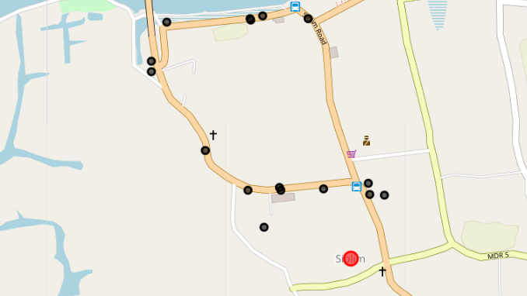
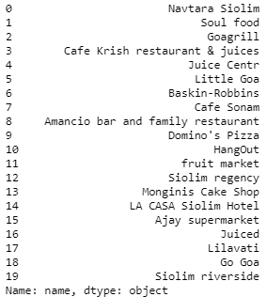
Map of the location
Studied other venues around the location such as eateries, beaches and super markets which are preferred by tourists when looking for hotels (20 such locations were found

Slide 7
Results

Slide 8
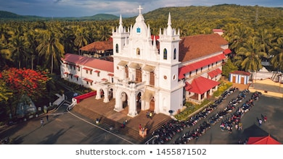
K-means clustering was used to identify the most probable coordinates for establishing my hotel
The final location was found to be 8.07985,77.54973
While this is an approximate location it provides a good rationale for somebody like me or any other entrepreneur to identify a most feasible location
There can be other factors such as property price, agricultural vs non-agricultural land which can be figured out once somebody visits the physical location
K-means was particularly helpful in comparing average distances of other venues and hotels from the locality

Slide 9
Discussions

Slide 10
The results are indicative based on the data available on foursquare
Searching other websites such as Google and MakemyTrip.com presents a lot of details which were found missing on running the query
With the constraint of using FourSquare and the restrictions related to the free account this is the data that can be made available.
This study is indicative of the co-ordinates and the best decisions can be taken while visiting the location in person

Slide 11
Conclusion

Slide 12
K-means clustering was used to identify the most probable coordinates for establishing my hotel
The final location was found to be 8.07985,77.54973
While this is an approximate location it provides a good rationale for somebody like me or any other entrepreneur to identify a most feasible location
There can be other factors such as property price, agricultural vs non-agricultural land which can be figured out once somebody visits the physical location
K-means was particularly helpful in comparing average distances of other venues and hotels from the locality

Slide 13
Thank You

